Slide 1

2024 Guide to
Online Submissions

Slide 2
e-Fest RULES AND ELIGIBILITY
For a complete list of rules and eligibility requirements, please refer to efest.biz - Rules & Eligibility
Submissions to e-Fest must:
  be made up of undergraduate students registered during 2024 spring semester or have graduated no earlier than fall 2023.
  attend a 4-year college or university in North America.
  have a team advisor, who is on the faculty or center staff at the university, able to validate the team's submission, and travel to Minneapolis, MN April 18-20, 2024.
Teams must have at least 2 and no more than 5 members.
Winning teams agree to allow their video submission and slides to be published by e-Fest, EIX, and The University of St. Thomas.

Slide 3
e-Fest
ONLINE SUBMISSION DELIVERABLES
Each team must:
  create a 15 Slide (not including a cover slide) presentation deck of their business plan
  produce a 7-minute (maximum) submission video that highlights their business concept pitch
  complete the online submission form on Reviewr
  submit the advisor approval form on Reviewr (includes verifying eligibility and submission legitimacy)
  See efest.biz - Rules & Eligibility for a complete list of eligibility and competition rules.

Slide 4
SUBMISSION
TIPS & TEMPLATES
The following slides cover how to create an effective slide deck for your e-Fest online submission and provides a sample pitch deck.
The information provided is based on feedback from e-Fest competitors, advisors, and judges.
The sample is merely meant for guidance.
Please add, delete, alter, and customize your team's slide deck for your own purposes.

Slide 5
KEY ELEMENTS OF A COMPETETIVE PITCH
Identify
Identify a real customer need
Describe
Describe a solution that is clear, understandable and meaningful for some set of customers – articulate the value proposition to those customers
Show
Show your advantage over competitors
Provide
Provide evidence of a large, growing market
Explain
Explain how you will deliver the solution to your customer affordably and effectively
Tell
How the venture will make money (revenue model)
Show
Show why deal is good for the investor

Slide 6
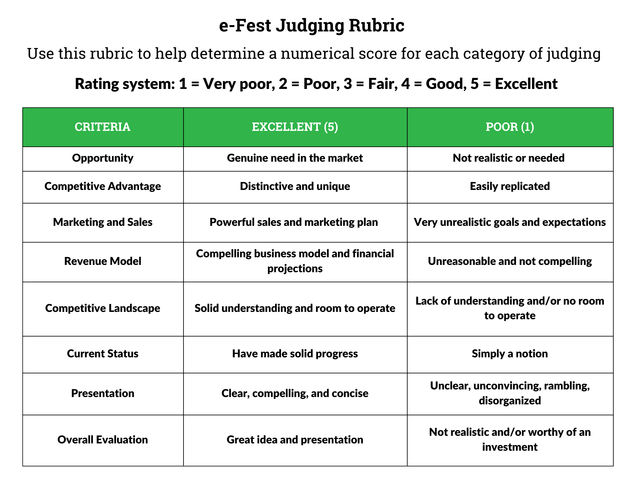
e-Fest JUDGING RUBRIC

Slide 7
THE SLIDE DECK

Slide 8
Cover Slide
Company Name
Company Logo
School/University You Represent
Team Members Names/Images

Slide 9
OPENING OVERVIEW
Get the audience excited about your opportunity! Help them quickly understand the scale and impact of the problem you are solving and the value of your solution.
Some techniques for engaging them:
Link the topic to their experience: “How many of you have ever experienced this…” (make sure it is the kind of problem the audience has experienced and would love to have fixed)
Paint a compelling picture with attention-getting statistics: “1 in 5 millennials suffers hearing loss. It can take less than 8 minutes of earbud use at high volumes for hearing to be damaged.”
Tell a story - Paint a picture of a particular person who is experiencing the problem you are solving, how it impacts them, and how you can transform their experience.”

Slide 10
DESCRIBE THE CUSTOMER NEED
Identify a real need – an unsolved problem or a problem that could be solved in a better way
Specify who needs your help – Who is the customer? How do they experience the problem and how does it impact their lives? What solutions have they tried and what are the shortcomings of those solutions?
Justify the revenue model - Explain why customers will pay for a solution

Slide 11
DESCRIBE YOUR SOLUTION
Provide a mockup of the product or service.
For example:
If it is an app - provide screen shots
If it is hardware - provide an illustrative representation
If it is a process or service - outline or diagram the process/service
This is the opportunity to show the judges the details and uniqueness of your business. Be as specific and detailed as possible.

Slide 12
OFFER A VALUE PROPOSITION
Explain how and why your solution solves the customer’s problem
Describe the specific benefits:
  Does it generate more revenue for customers?
  Does it cut customer time, effort or costs?
  Does it increase customer efficiency, physical or emotional well-being, social connection, etc.?
  Does is it allow customers to do something in a new, different and/or better way?
Show how it’s better than alternatives

Slide 13
HIGHLIGHT YOUR COMPETITIVE ADVANTAGE
Explain why your effort is distinctive and unique
Show why it’s not an easy solution for competitors to replicate
Explain why customers can’t switch suppliers easily
Reference your competitive advantage (patents, expertise, scale)
Show how your company is an improvement over competitors' offerings

Slide 14
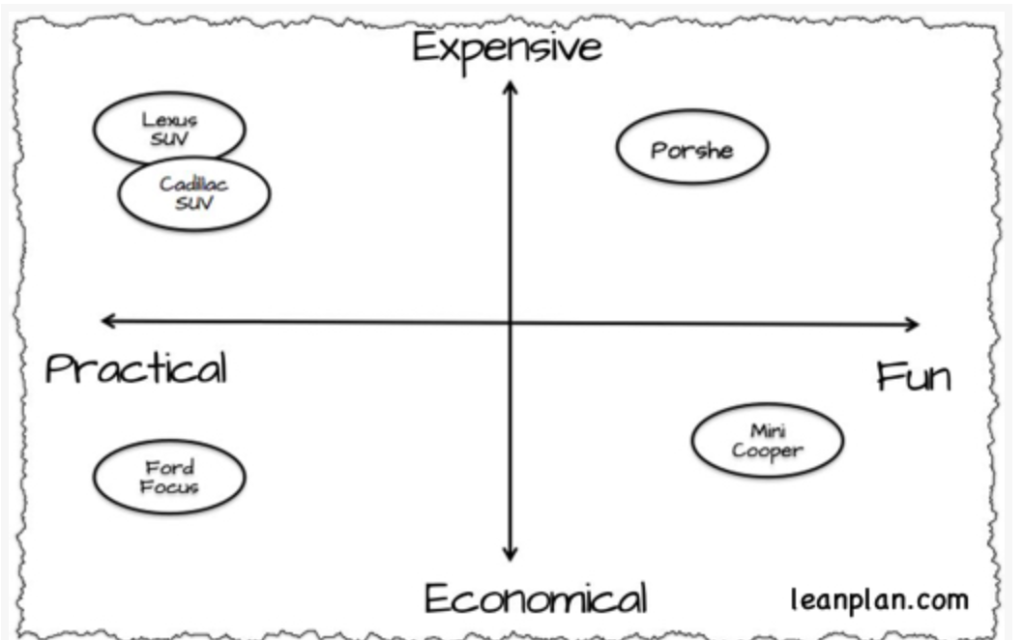
SUMMARIZE COMPETITIVE LANDSCAPE
Provide some form of competitive landscape analysis, ex:
Competitive feature analysis:
 | My Offer | Competitor 1 | Competitor 2 | Competitor 3
Price | Low | High | High | High
Speed | Fast | Medium | Slow | Fast
Maintenance | None | Medium | High | Medium
Competitive positioning matrix:

Slide 15
PROVIDE EVIDENCE OF MARKET OPPORTUNITY
Provide evidence the market exists, is significant, and is growing:
How many people experience this problem/ fit your target description? How many people can you impact/ or the number of customers you can reasonably address?
How much money is currently spent in this or related space? (in order to demonstrate that demand exists)
Why is this a good time to launch this venture – are there any market/industry/technology trends that create a particularly compelling window of opportunity?

Slide 16
DESCRIBE YOUR BUSINESS MODEL
How will you deliver this solution to your customer affordably and effectively, and how will the venture make money (revenue model)?
  Who is going to pay for this? The end user? Someone who purchases for an end user? Another stakeholder?
  How will they pay for this? (Fee for product/service? Subscription? Freemium? Licensing?)
  Provide enough explanation of how you will provide this product/service that your audience will see why it is a feasible business
  What are the largest costs and how will your company afford them?

Slide 17
INTRODUCE YOUR TEAM
Explain why you are the people to do this!
(Member 1 Name)​
(Member 1 Role on team)​
(Member 1 Key facts that make them an asset)​
​
(Member 2 Name)​
(Member 2 Role on team)​
(Member 2 Key facts that make them an asset)
(Member 3 Name)
(Member 3 Role on team)
(Member 3 Key facts that make them an asset)…

Slide 18
SUMMARIZE WHY JUDGES SHOULD BE EXCITED ABOUT YOUR BUSINESS
Provide a product/service positioning statement:
  To: (target customer) our (product/service) is the one (category) that (key benefit) unlike (nearest alternative).
  Example: For consumers who want to purchase a wide range of products online with quick delivery, Amazon provides a one-stop online shopping site that sets itself apart from other online retailers with its customer obsession, passion for innovation, and commitment to operational excellence.
  Remind them of any other facts – market trends, competitive advantage, etc. – that make this an exciting opportunity

Slide 19
EXAMPLE OF AN EFFECTIVE SLIDE DECK

Slide 20
ADDITIONAL TIPS FOR COMPETITIVE SLIDE DECKS
Edit your pitch to one idea per slide.
Review the judging rubric to ensure that your pitch aligns with the judging criteria
Aim to use visuals more than words
  Use charts and graphs to convey quantitative information
  Use simple visuals/photos for qualitative information that can’t be graphed.
Check out this link for examples of great pitch decks for successful businesses.

Slide 21
THE SUBMISSION VIDEO

Slide 22
e-Fest SUBMISSION VIDEO REQUIREMENTS
Video submissions should be up to a 7-minute pitch.
This is the storied “rocket pitch” and should convey the key attributes of the opportunity, as depicted in the pitch deck.
Video files should be uploaded to the e-Fest Drop Box account on the Reviewr site.
Video must be uploaded in one of these video file formats: .MOV, .WMV, .MP4.
Video submissions that are not uploaded correctly or exceed the maximum 7-minute time limit will not proceed to online judging.

Slide 23
CREATING YOUR VIDEO PITCH
Your goal is to be clear, succinct and compelling!
Tell a compelling story (highlighted by numbers not the other way around)
Highlight your business name and logo in your video
Make sure to keep the background simple enough that it does not distract.
Know your audience
DO NOT READ from the slide deck
Dress like you take your business seriously
7-minute max!

Slide 24
THE 7-MINUTE PITCH
Start strong!
  Grab them with a story, a question, a bold claim that relates to the need you are addressing or the solution you are providing
  Introduce yourself, your team, and your company.
Keep it simple and clear
  Here is the problem and why it is important.
  Here is our solution and why it meets the needs of our customers better than anything else out there.
  Here is how we are going to make it happen profitably
Close strong!
  What’s the most important thing you want your audience to remember?
  What is a memorable, creative way to accomplish that?

Slide 25
ENGAGE THE AUDIENCE
Be relaxed and conversational, but express conviction for your ideas
Present yourself and your business professionally – dress appropriately for your business
See yourself as telling a story
  Pick words that create a visual image in listener’s mind
  Choose powerful words that grab attention
Be sure to edit your video submission for clarity, sound, and visual consistency. If the judges can't hear you, they won't be able to judge your pitch appropriately.
Check out examples of winning e-Fest submission videos:
  2021 e-Fest Grand Champion - Nutrivide
  2022 e-Fest Finalist - Fib

